Slide 1
Validation Control

Slide 2
The Validation controls are used for validating the data entered in controls.
When any user enters the data on a text Box (web page) and submits the page on the server ,then validation controls are used to check the data field entered by the user .if any data entered by the user is invalid (not correct format) then validation control displays an error message on the screen.
All the error message is defined as properties values of validation controls. All the validation controls comes under System.UI.Webcontrols Namespace. There are some validation controls ,that are used in ASP.NET.Which are given below :
The RequiredField Validator control
The RangeValidator control
The RegularExpressionValidator control
The CompareValidator control
The customValidator control
The Validationsummary control
Change Web.Config file →Under configuration tag
<appSettings>
<add key="ValidationSettings:UnobtrusivevalidationMode" value="None"></add>
</appSettings>

Slide 3
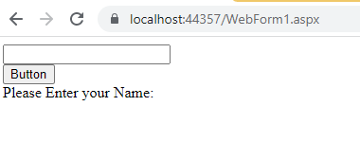
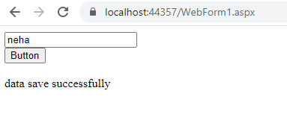
The RequiredFieldValidator control:-
It is used to check that there must be some value specify within the control.
Properties:- Some important properties are given below:-
ControlToValidate:- It is used to set the control field (text box) for validation.
Initial value:- It is only guidance for user which display default in the control.This property can be used for drop down list.
Text :- It is used to set the text value (Name) to the validation control.
Example:
<asp:TextBox ID="txtName" runat="server"> </asp:TextBox>
<asp:RequiredFieldValidator ID="rfvName" runat="server" ErrorMessage="Please enter Name" ControlToValidate="txtName"> </asp:RequiredFieldValidator>

Slide 4
WebForm1.aspx
<body>
<form id="form1" runat="server">
<div>
<asp:TextBox ID="TextBox1" runat="server"></asp:TextBox><br />
<asp:DropDownList ID="DropDownList1" runat="server">
<asp:ListItem Text="Select Gender" Value="-1"></asp:ListItem>
<asp:ListItem Text="Male"></asp:ListItem>
<asp:ListItem Text="Female"></asp:ListItem>
</asp:DropDownList>
<asp:RequiredFieldValidator ID="RequiredFieldValidator2" runat="server" InitialValue="-1" ErrorMessage="Please select your Gender" ControlToValidate="DropDownList1" Text="*"></asp:RequiredFieldValidator><br />
<asp:Button ID="Button1" runat="server" Text="Button" OnClick="Button1_Click" /><br />
<asp:RequiredFieldValidator ID="RequiredFieldValidator1" runat="server" ErrorMessage="Please Enter your Name:" ControlToValidate="TextBox1"></asp:RequiredFieldValidator><br />
<asp:Label ID="Label1" runat="server" Text=""></asp:Label>
<br />
</div>
</form>
</body>

Slide 5
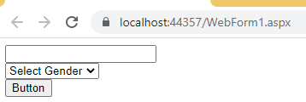
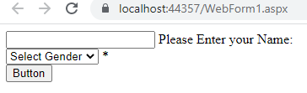
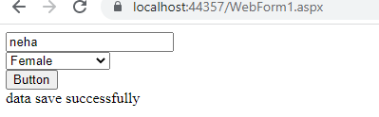
WebForm1.aspx.cs
protected void Button1_Click(object sender, EventArgs e)
{
if (Page.IsValid)
{
Label1.Text = "data save successfully";
}
else
{
Label1.Text = "Validation Fail";
}
}

Slide 6
CompareValidator Control
CompareValidator control compare user inputted value with the another input control value or a constant value. comparevalidator validation success if inputted value matches the criteria specified by the Operator, ValueToCompare or ControlToCompare property. comparevalidator Type property indicate whether inputted value need to converted to specified data type (string, date, currency, double or integer). ControlToValidate property indicate which control need to validate. ControlToCompare property indicate which control need to compare with inputted value (such as TextBox value). ValueToCompare property indicate that you want to compare inputted value with a constant value instead other control value. Don't put ControlToValidate and ValueToCompare properties together in a comparevalidator control. you can use any one property at a time. that means you can only compare with a control or compare with a constant value at the same time. you can use the Operator property to specify the type of comparison to perform, such as equal to, greater than, equal, not equal, less than, less than equal, data type check etc. Operator property value DataTypeCheck validated the data type specified by the Type property. so the comparevalidator validation fails if the inputted value cannot be converted to the specified data type.

Slide 7
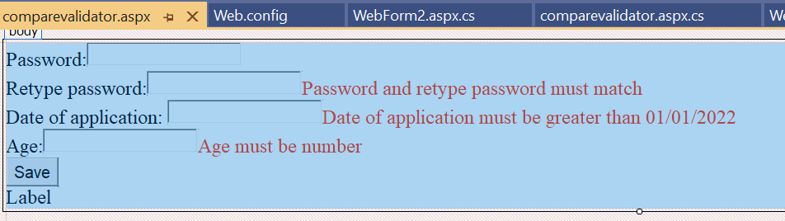
Design following form

Slide 8
Comparevalidator.aspx
Password:<asp:TextBox ID="TextBox1" runat="server" TextMode="Password"></asp:TextBox><br />
Retype password:<asp:TextBox ID="TextBox2" runat="server" TextMode="Password"></asp:TextBox>
<asp:CompareValidator ID="CompareValidator1" runat="server" ErrorMessage="Password and retype password must match" ControlToValidate="TextBox2" ControlToCompare="TextBox1" Operator="Equal" Type="String" ForeColor="#FF3300"></asp:CompareValidator><br />
Date of application: <asp:TextBox ID="TextBox3" runat="server"></asp:TextBox>
<asp:CompareValidator ID="CompareValidator2" runat="server" ErrorMessage="Date of application must be greater than 01/01/2022" ControlToValidate="TextBox3" ValueToCompare="01/01/2022" Operator="GreaterThan" Type="Date" ForeColor="#FF3300"></asp:CompareValidator><br />
Age:<asp:TextBox ID="TextBox4" runat="server"></asp:TextBox>
<asp:CompareValidator ID="CompareValidator3" runat="server" ErrorMessage="Age must be number" Operator="DataTypeCheck" ControlToValidate="TextBox4" Type="Integer" ForeColor="#FF3300"></asp:CompareValidator><br />
<asp:Button ID="Button1" runat="server" Text="Save" OnClick="Button1_Click" />
<br />
<asp:Label ID="Label1" runat="server" Text="Label"></asp:Label>

Slide 9
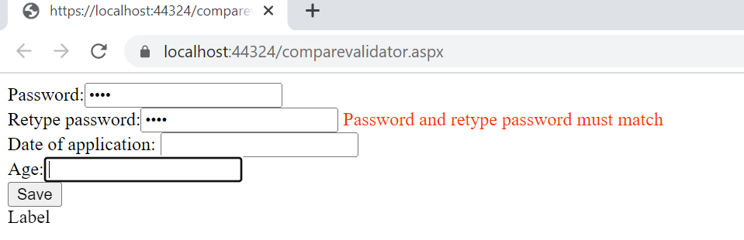
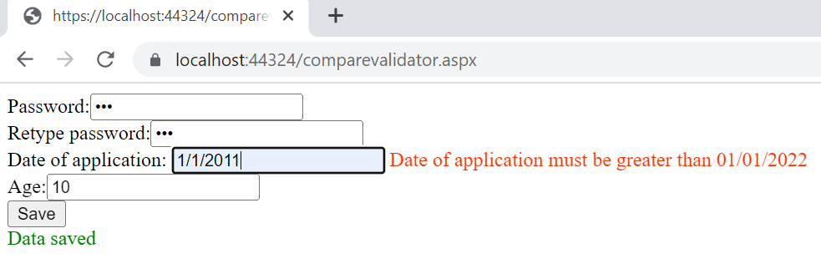

Slide 10
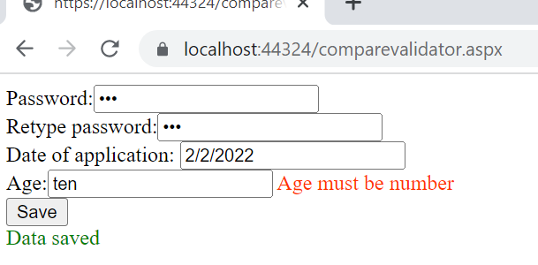

Slide 11
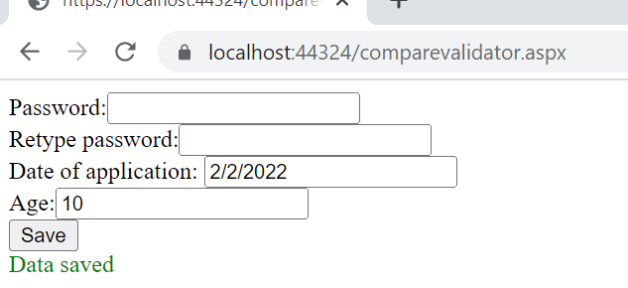
Comparevalidator.aspx.cs
protected void Button1_Click(object sender, EventArgs e)
{
if(Page.IsValid)
{
Label1.Text = "Data saved";
Label1.ForeColor = System.Drawing.Color.Green;
}
else
{
Label1.Text = "Falidation Failed ,Data not saved";
Label1.ForeColor = System.Drawing.Color.Red;
}}

Slide 12
RangeValidator Control
The RangeValidator control is used to check the input control value is within a specified range or not.
In other words we can say the input values must be between two defined values. It has minimum and maximum value.
RangeValidator control mostly used for a validate Mobile No and Pincode. Mobile no and Pincode no length must be pre defined.

Slide 13
<form id="form1" runat="server">
<div>
Age:<asp:TextBox ID="TextBox1" runat="server"></asp:TextBox>
<asp:RangeValidator ID="RangeValidator1" runat="server" ErrorMessage="Age must be between 1 and 100" ControlToValidate="TextBox1" ForeColor="Red" MinimumValue="1" MaximumValue="100" Type="Integer" Display="Dynamic"></asp:RangeValidator>
<asp:RequiredFieldValidator ID="RequiredFieldValidator1" runat="server" ErrorMessage="Provide age" ControlToValidate="TextBox1" Display="Dynamic"></asp:RequiredFieldValidator>
<br />
<asp:Button ID="Button1" runat="server" Text="Button" OnClick="Button1_Click" /><br />
<asp:Label ID="Label1" runat="server" Text="Label"></asp:Label>
</div>
</form>

Slide 14
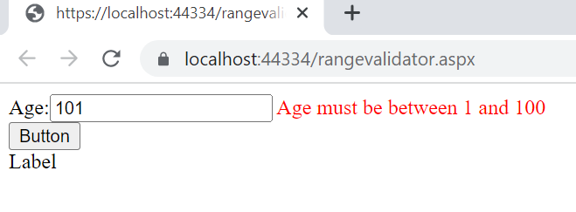
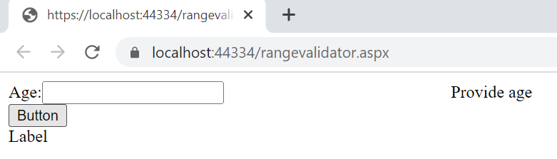
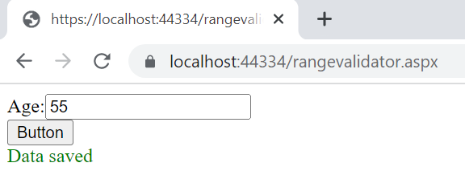
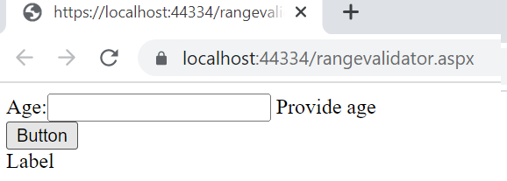
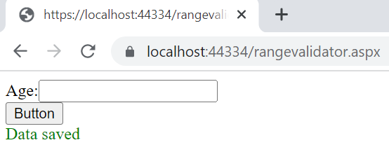
RangeValidator Control

Slide 15
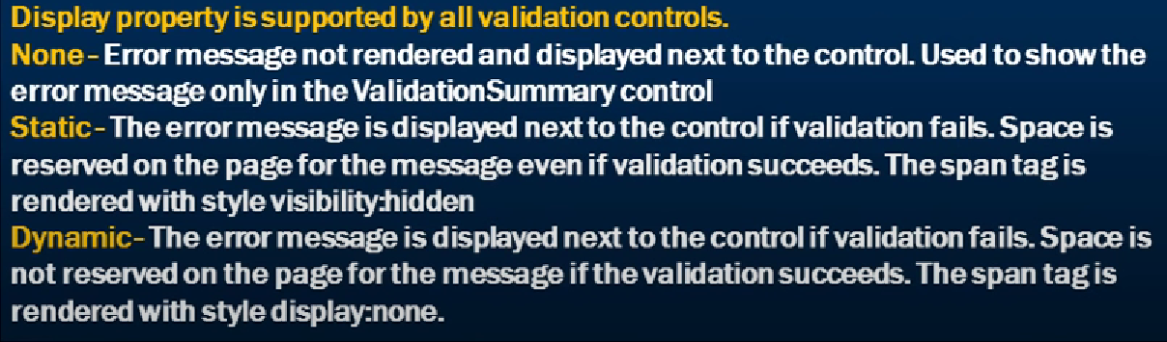

Slide 16
Regular Expression
A regular expression is a powerful pattern matching language that can be used to identify simple and complex characters sequence that would otherwise require writing code to perform.
Using RegularExpressionValidator server control, you can check a user's input based on a pattern that you define using a regular expression.
It is used to validate complex expressions. These expressions can be phone number, email address, zip code and many more. Using Regular Expression Validator is very simple. Simply set the ValidationExpression property to any type of expression you want and it will validate it.

Slide 17
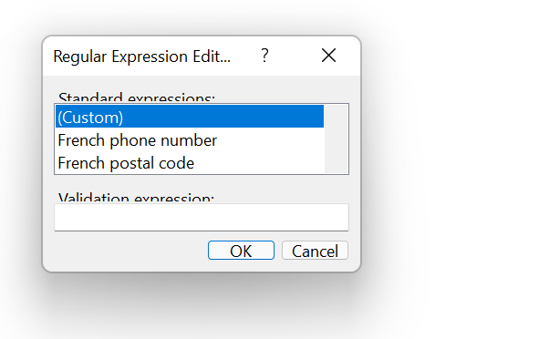
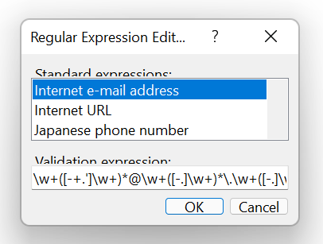
Regular Expression
Select regular expression from the design view-→properties-→validation expression

Slide 18
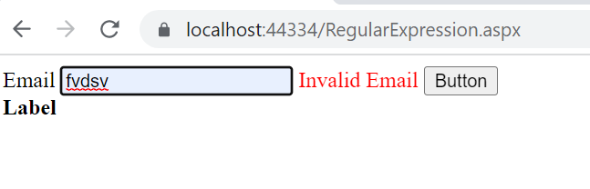
RegularExpression.aspx
<div>
Email
<asp:TextBox ID="TextBox1" runat="server"></asp:TextBox>
<asp:RegularExpressionValidator ID="RegularExpressionValidator1" runat="server" ErrorMessage="Invalid Email" ControlToValidate="TextBox1" ValidationExpression="\w+([-+.']\w+)*@\w+([-.]\w+)*\.\w+([-.]\w+)*" ForeColor="red"></asp:RegularExpressionValidator>
<asp:Button ID="Button1" runat="server" Text="Button" />
<br />
<asp:Label ID="Label1" runat="server" Text="Label" Font-Bold="true"></asp:Label>
</div>

Slide 19
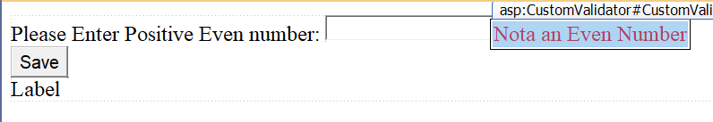
CustomValidator Control
CustomValidator control enables you to create your own validation and that validation can run with the other validation control on the page.
The CustomValidator control performs validation, based upon your code, you write.
You can write validation code that will be executed on the client side using JavaScript,or with server-side validation. The CustomValidator control can work client-side, server-side, or both.

Slide 20
Customvalidator.aspx
<form id="form1" runat="server">
<div>
Please Enter Positive Even number: <asp:TextBox ID="TextBox1" runat="server"></asp:TextBox>
<asp:CustomValidator ID="CustomValidator1" runat="server" ErrorMessage="Nota an Even Number" ControlToValidate="TextBox1" OnServerValidate="CustomValidator1_ServerValidate" ForeColor="red" ValidateEmptyText="True"></asp:CustomValidator><br />
<asp:Button ID="Button1" runat="server" Text="Save" OnClick="Button1_Click" style="height: 35px" /><br />
<asp:Label ID="Label1" runat="server" Text="Label"></asp:Label>
</div>
</form>

Slide 21
Customvalidator.aspx.cs
protected void CustomValidator1_ServerValidate(object source, ServerValidateEventArgs args)
{
if (args.Value == "")
{
args.IsValid = false;
}
else
{
int Number;
bool isNumber = int.TryParse(args.Value, out Number);
if (isNumber && Number>0 && Number % 2 == 0)
{
args.IsValid = true;
}
else
{
args.IsValid = false;
}
}
}

Slide 22
Customvalidator.aspx.cs
protected void Button1_Click(object sender, EventArgs e)
{
if (Page.IsValid)
{
Label1.Text = "Data saved";
Label1.ForeColor = System.Drawing.Color.Green;
}
else
{
Label1.Text = "Falidation Failed ,Data not saved";
Label1.ForeColor = System.Drawing.Color.Red;
}
}

Slide 23
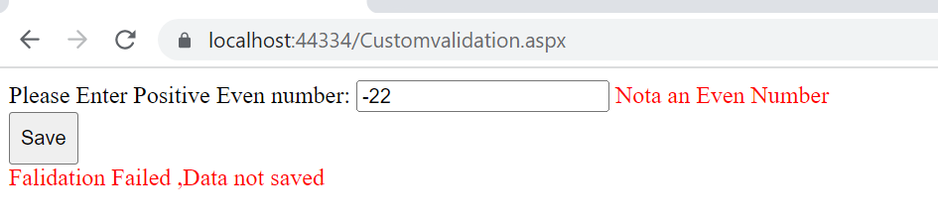
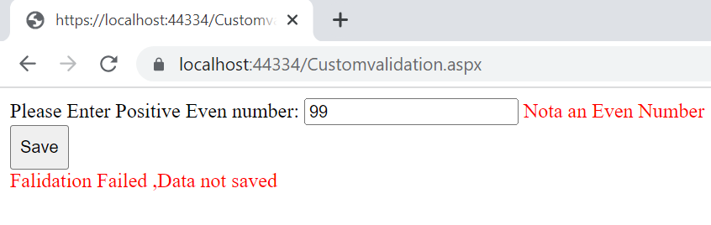

Slide 24
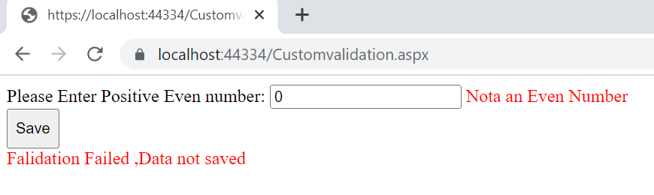
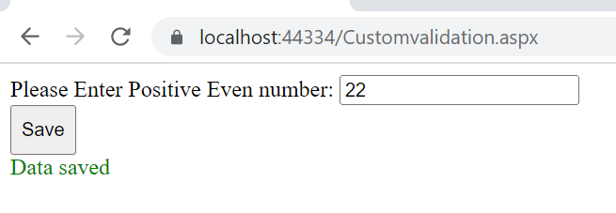

Slide 25
ValidationSummary
ASP.NET has provided an additional control that complements the validator controls.
The ValidationSummary control is reporting control, which is used by the other validation controls on a page.
You can use this validation control to consolidate errors reporting for all the validation errors that occur on a page instead of leaving this up to each and every individual validation control.

Slide 26
Validationsummary.aspx
<div>
EMAIL:<asp:TextBox ID="TextBox1" runat="server"></asp:TextBox>
<asp:RequiredFieldValidator ID="RequiredFieldValidator1" runat="server" ErrorMessage="EMAIL IS REQUIRED" ControlToValidate="TextBox1" ForeColor="Red" Display="Dynamic">*</asp:RequiredFieldValidator>
<asp:RegularExpressionValidator ID="RegularExpressionValidator1" runat="server" ErrorMessage="INVALID EMAIL" ControlToValidate="TextBox1" ForeColor="Red" ValidationExpression="\w+([-+.']\w+)*@\w+([-.]\w+)*\.\w+([-.]\w+)*" Display="Dynamic"></asp:RegularExpressionValidator><br />
USER NAME:<asp:TextBox ID="TextBox2" runat="server"></asp:TextBox>
<asp:RequiredFieldValidator ID="RequiredFieldValidator2" runat="server" ErrorMessage="USERNAME IS REQUIRED" ControlToValidate="TextBox2" ForeColor="RED"></asp:RequiredFieldValidator><br />
PASSWORD:<asp:TextBox ID="TextBox3" runat="server" TextMode="Password"></asp:TextBox>
<asp:RequiredFieldValidator ID="RequiredFieldValidator3" runat="server" ErrorMessage="PASSWORD IS REQUIRED" ControlToValidate="TextBox3" ForeColor="RED">*</asp:RequiredFieldValidator><br />
CONFIRM PASSWORD:<asp:TextBox ID="TextBox4" runat="server" TextMode="Password"></asp:TextBox>
<asp:RequiredFieldValidator ID="RequiredFieldValidator4" runat="server" ErrorMessage="CONFIRM PASSWORD IS REQUIRED" ControlToValidate="TextBox4" ForeColor="RED" Display="Dynamic">*</asp:RequiredFieldValidator><br />
<asp:CompareValidator ID="CompareValidator1" runat="server" ErrorMessage="password and confirm password should be same" ControlToValidate="TextBox4" ControlToCompare="TextBox3" ForeColor="red" Type="String" Operator="Equal" Display="Dynamic">*</asp:CompareValidator><br />
<asp:Button ID="Button1" runat="server" Text="SAVE" OnClick="Button1_Click" />
<br />
<asp:ValidationSummary ID="ValidationSummary1" runat="server" />
<br />
<asp:Label ID="Label1" runat="server" Text="Label"></asp:Label>
</div>

Slide 27
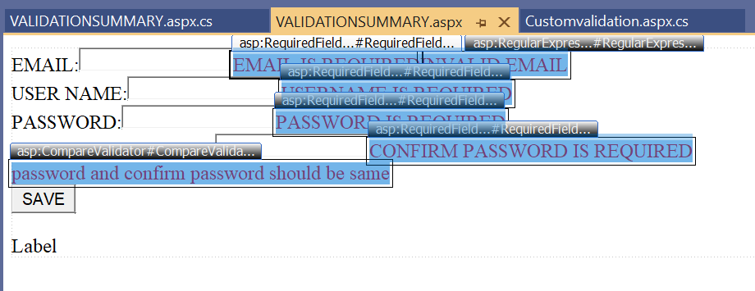
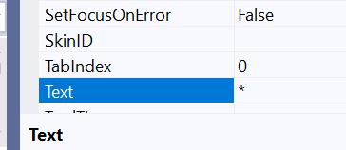
Select all and-→set text property to *

Slide 28
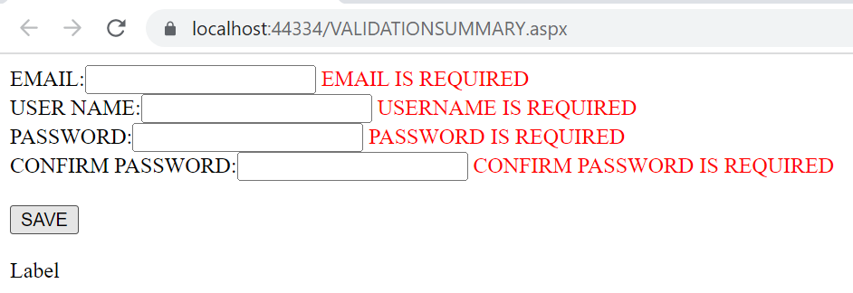

Slide 29
